Slide 1
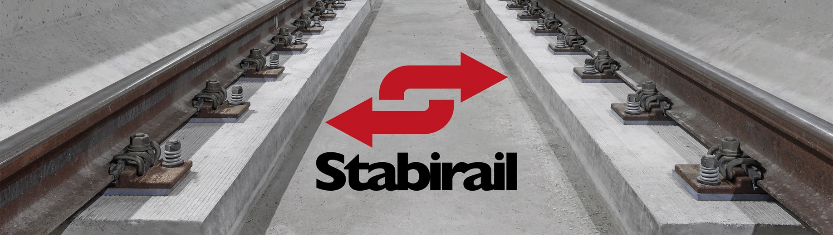
FAST TRACK TO SUCCESS
SLAB TRACK SOLUTION OF STABIRAIL COMBINES ACCURACY AND DURABILITY

Slide 2
Equipment
Complete Stabirail equipment:
Concrete Milling Machine
Diamond Drilling train
Anchoring Train
Tanker (10 000 litres water and 2 500 litres diesel)
Lorry with water tank

Slide 3
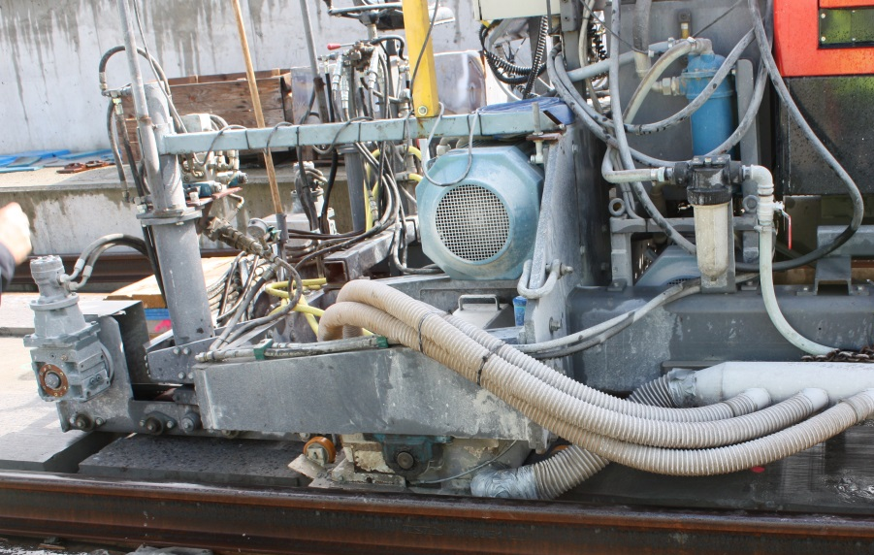
Working method
Concrete Milling Machine:
mills the concrete rail beds with millimeter accuracy

Slide 4
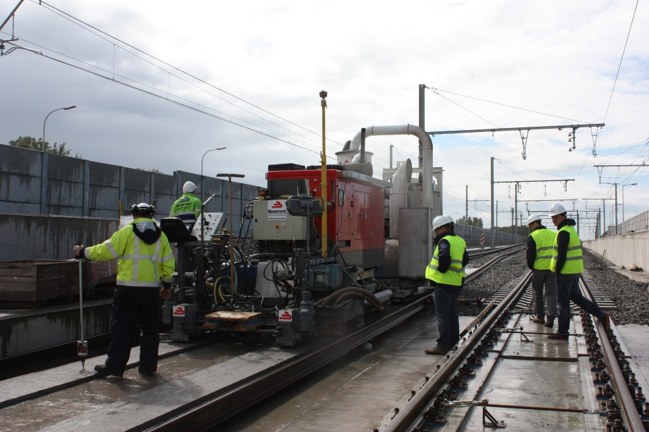
Working method
Concrete Milling Machine:
rail beds are milled simultaneously

Slide 5
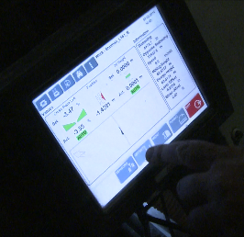
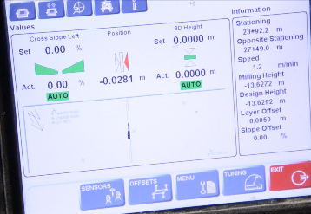
Working method
Concrete Milling Machine:
operated by 3D system

Slide 6
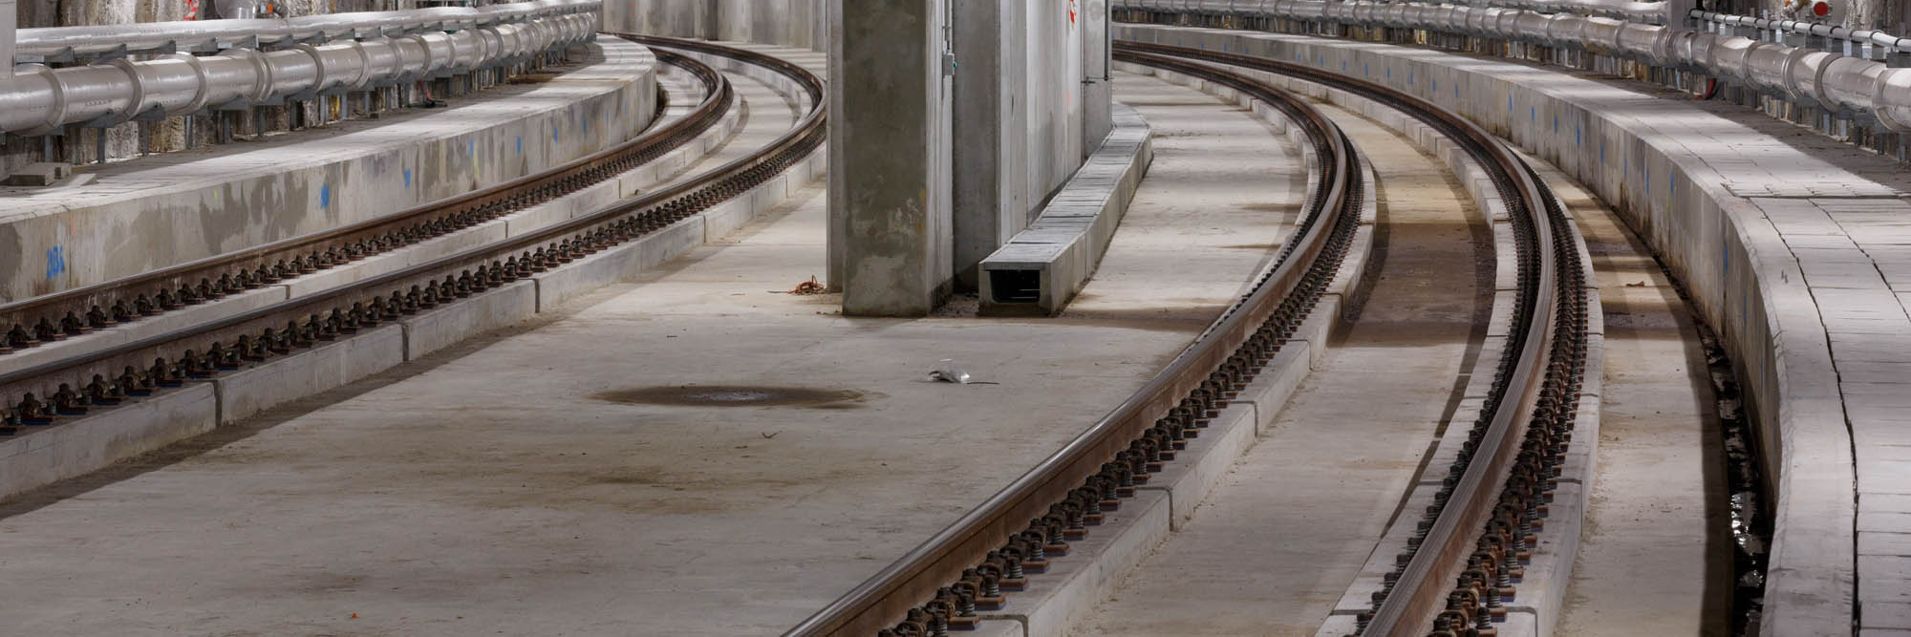
Working method
Concrete Milling Machine:
capable of working on parabolic transitional curves and transitional slopes

Slide 7
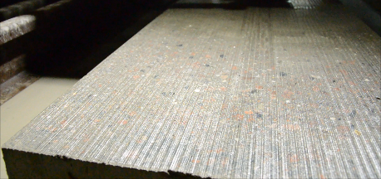
Working method
Concrete Milling Machine:
diamond discs are water cooled (no dust formation)

Slide 8
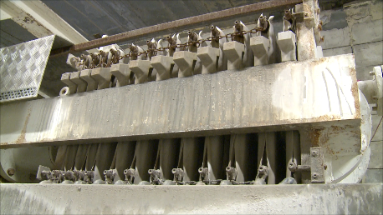
Working method
Concrete Milling Machine:
sludge is separated

Slide 9
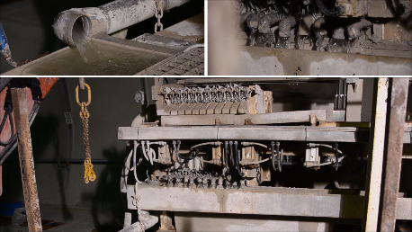
Working method
Concrete Milling Machine:
cooling water is reused

Slide 10
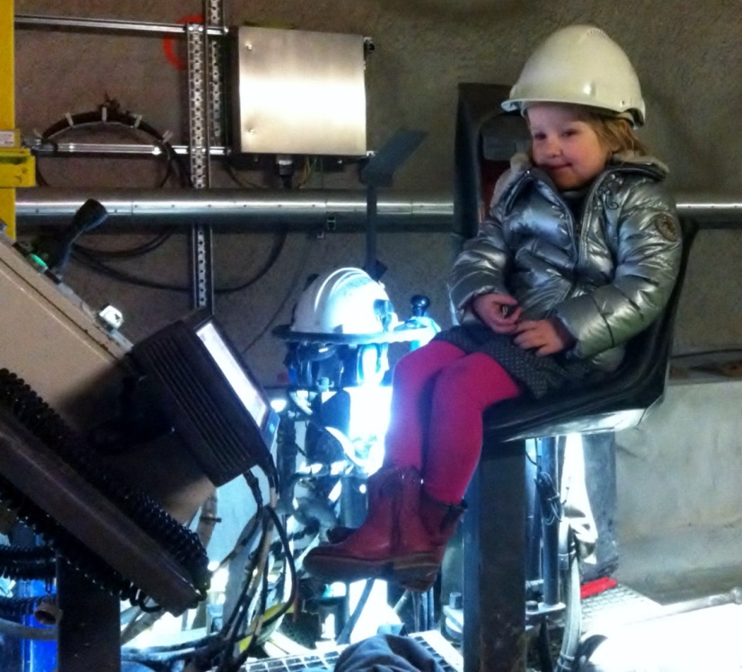
Working method
Concrete Milling Machine:
operates autonomously

Slide 11
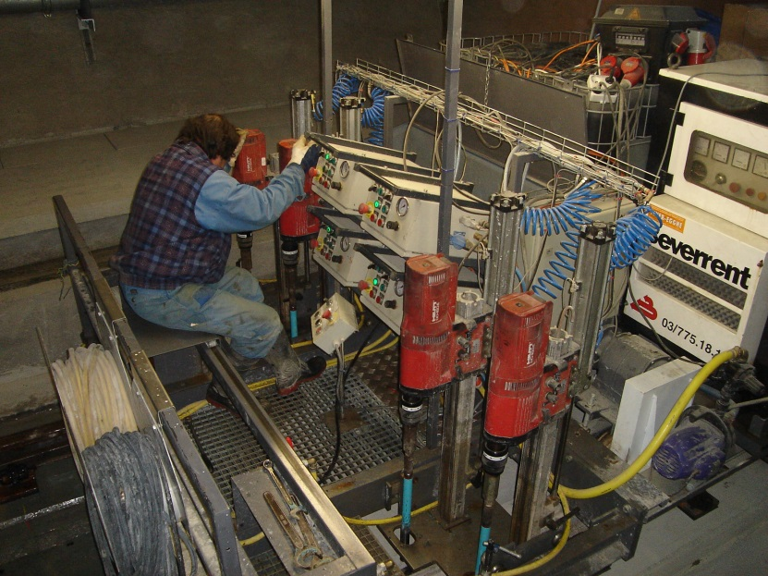
Working method
Drilling Train:
Cores diamond drilled holes in the concrete bed

Slide 12
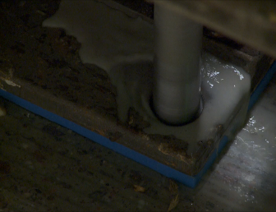
Working method
Drilling Train:
Water cooled
Works autonomously

Slide 13
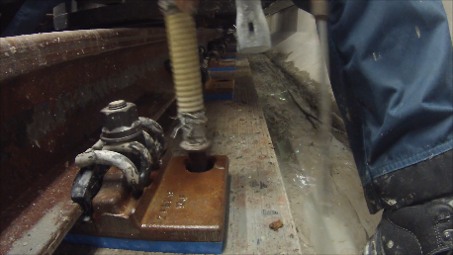
Working method
Anchoring Train:
Cleans the holes

Slide 14
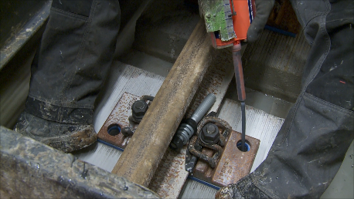
Working method
Anchoring Train:
Fixes the anchors with a chemical adhisive
Works autonomously

Slide 15
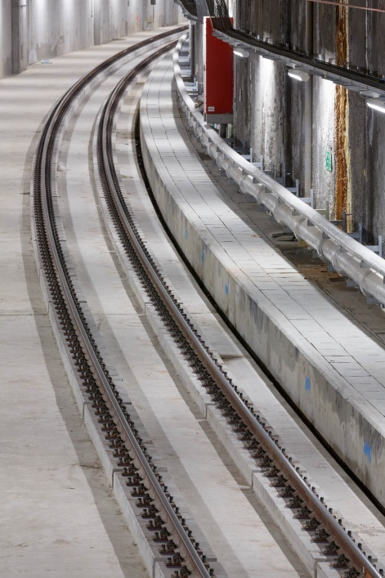
Efficiency
Concrete Milling Machine
At max. 10 mm to be milled
At max. 20 mm to be milled
* Limestone based concrete
200 m/8h – 600 m/24h
135 m/8 h – 400 m/24h

Slide 16
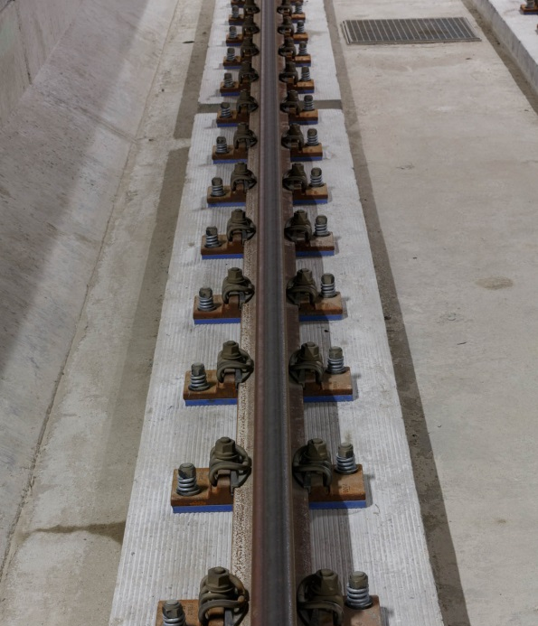
Efficiency
Drilling Train:
150m/8h = 450m/24h*
  Limestone based concrete
  Max. coring diameter: 32mm
  Max. coring dept: 130mm
  Max. diameter of rebar: 12mm

Slide 17
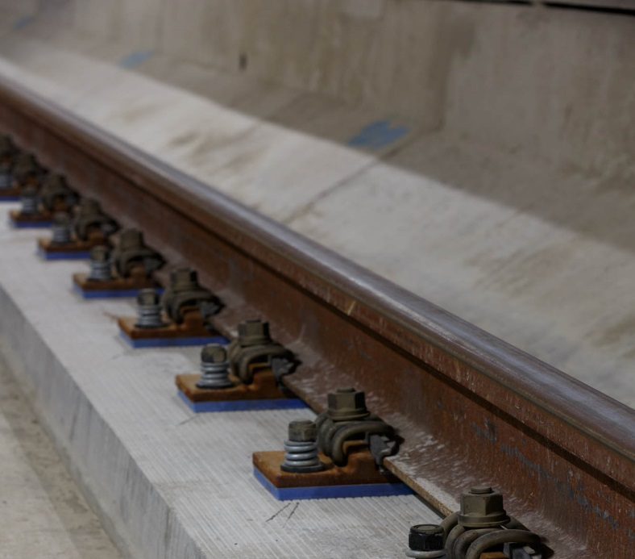
Efficiency
Anchoring Train:
Cleaning drilled holes
Achoring drilled holes
300 m/8h – 900 m/24h
300 m/8 h – 900 m/24h
1 machine, 2 actions
=
150m/8h

Slide 18
Advantages
Advantages:
Fast working method (200m/8h)
No movement of the machines IN and OUT of the tunnel; the machines remain on site
2 mm accuracy
Reduced vibration to the tunnel construction and buildings above
Shallow construction height of the tunnel
Reduced dead load
Higher speed operation
Very low maintenance requirements
Long design life = Low whole-life cost

Slide 19
Drawings
Drawings:

Slide 20
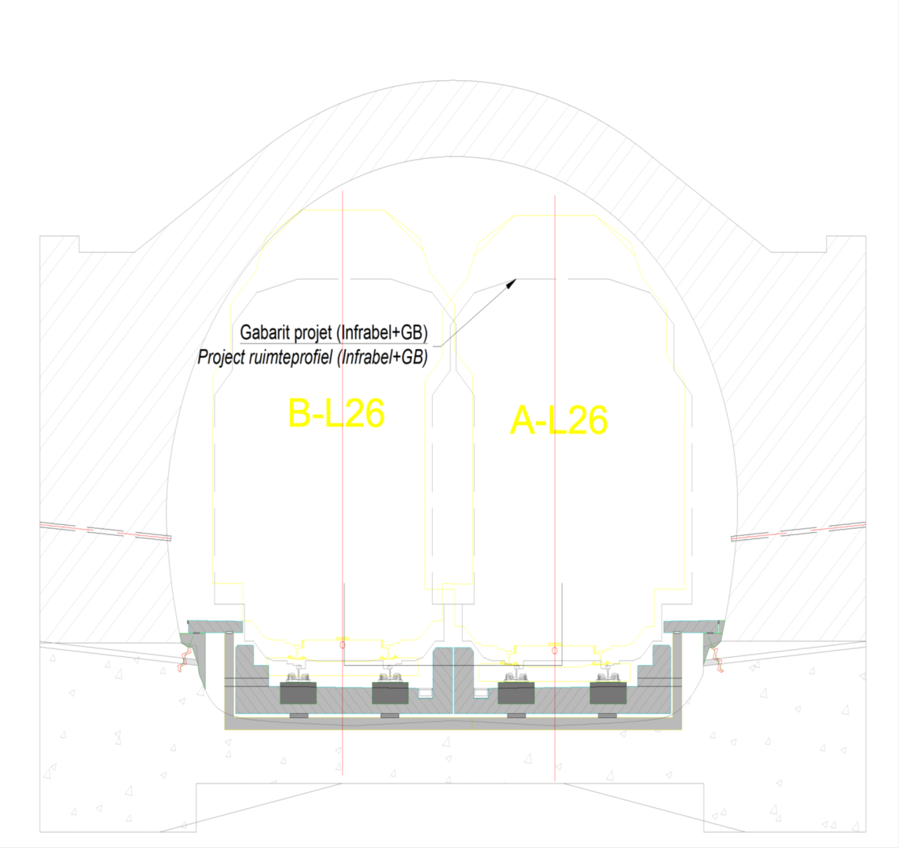
Drawings
Drawings:

Slide 21
Drawings
Drawings:

Slide 22
Drawings
Drawings:

Slide 23
Drawings
Drawings:

Slide 24
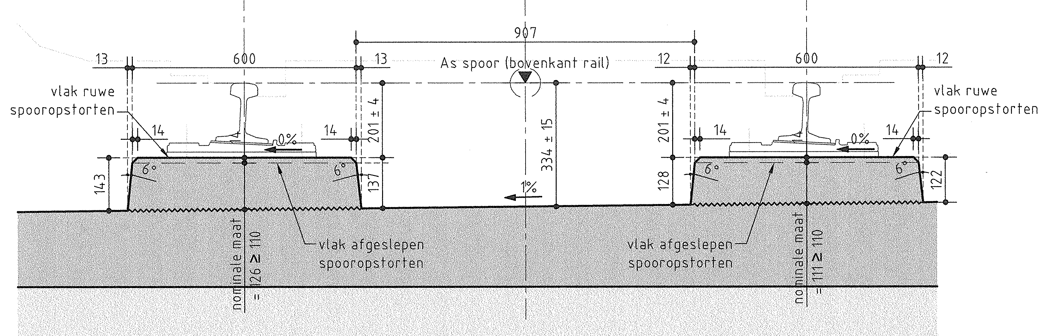
Drawings
Drawings:

Slide 25
Drawings
Drawings:

Slide 26
Drawings
Drawings:

Slide 27
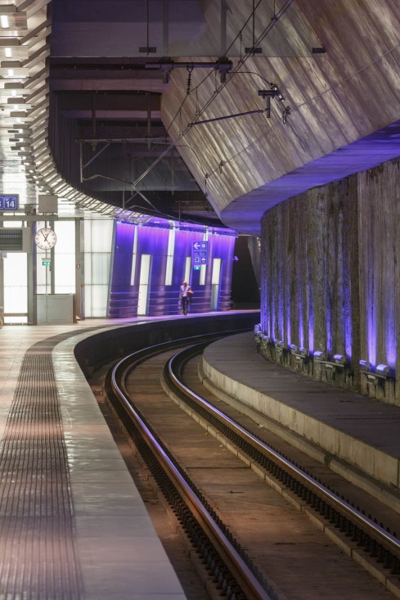
References
Antwerp Central Station
2004
8,3 km track length
53 484 rail anchors
5 rail switches
2 463 rail anchors

Slide 28
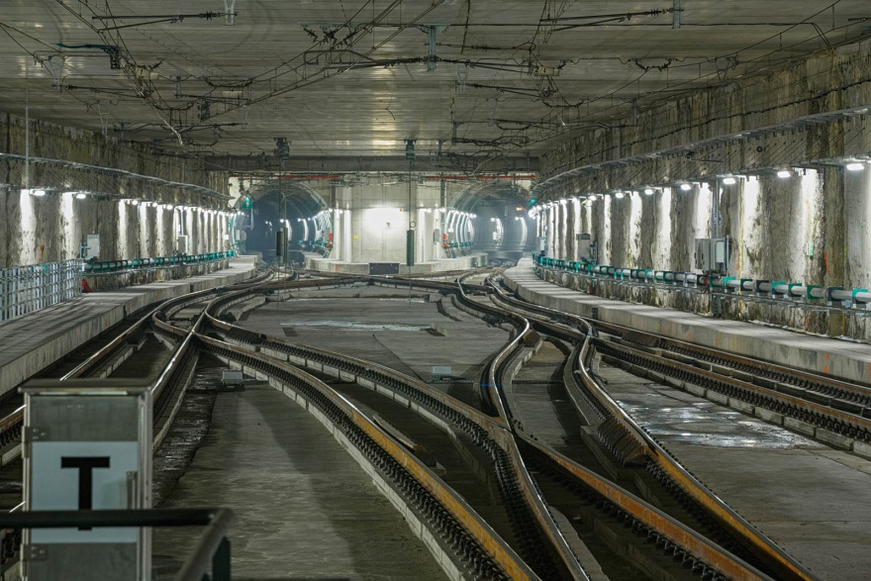
References
Diabolo Tunnel
Brussels Airport 2009
9,5 km track length
60 620 rail anchors
10 rail switches
7 480 rail anchors

Slide 29
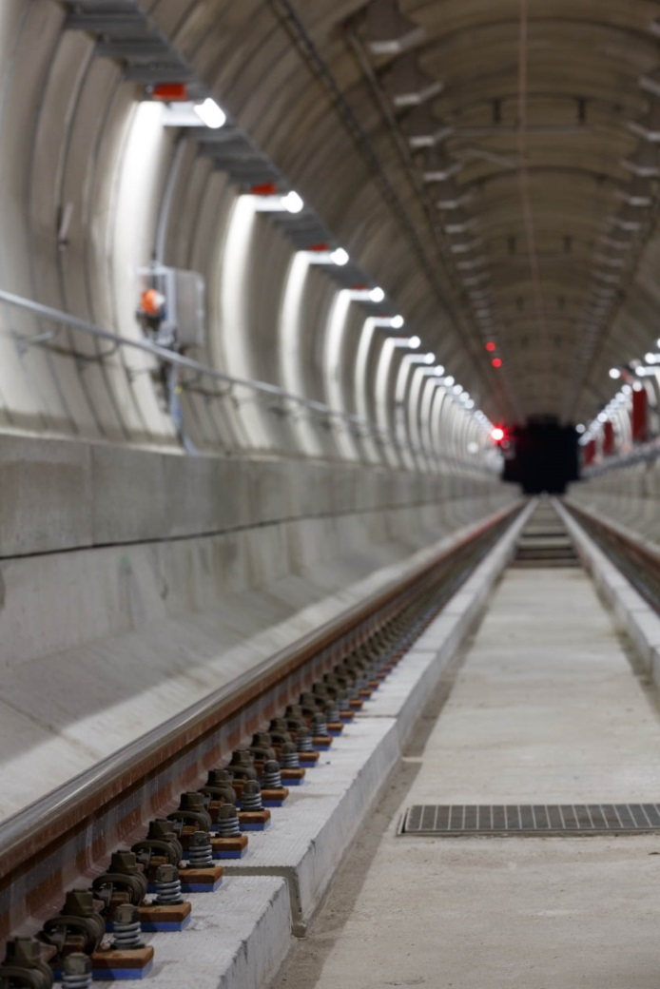
References
Liefkenshoektunnel
Port of Antwerp 2013
16,6 km track length
110 564 rail anchors

Slide 30
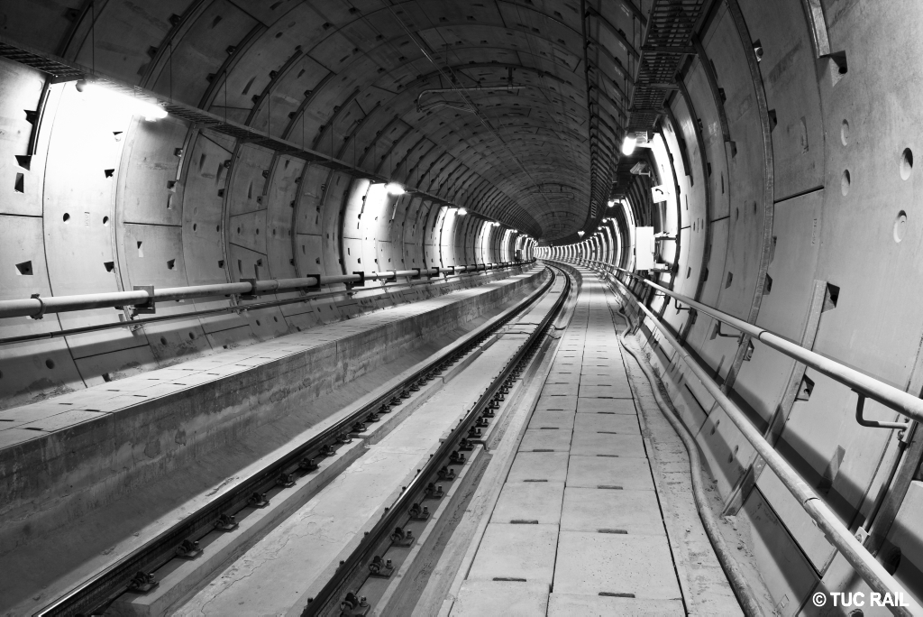
References
Shuman JosaphatTunnel
Brussels 2014
4,2 km track length
27 168 rail anchors
5 rail switches
2 357 rail anchors

Slide 31
FAST TRACK TO SUCCESS
Watch our video on www.stabirail.com
Contact us for a visit or more information

